Slide 1
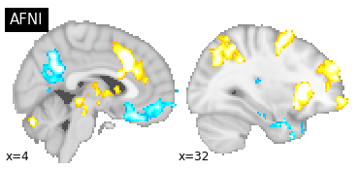
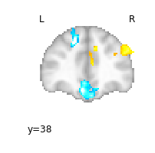
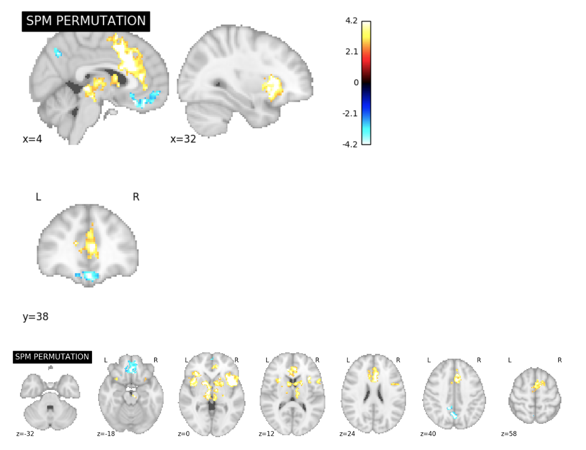
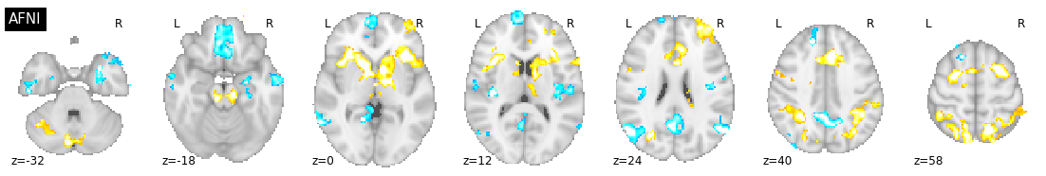
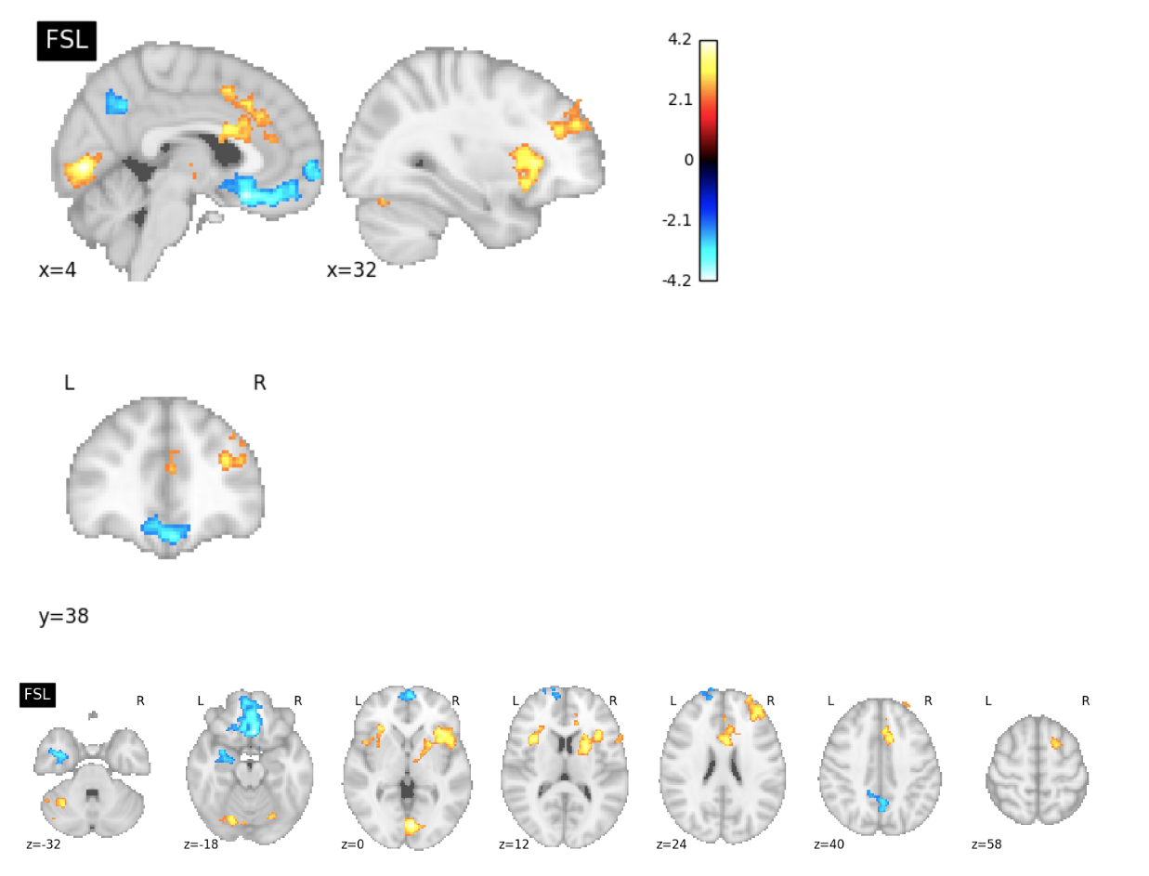
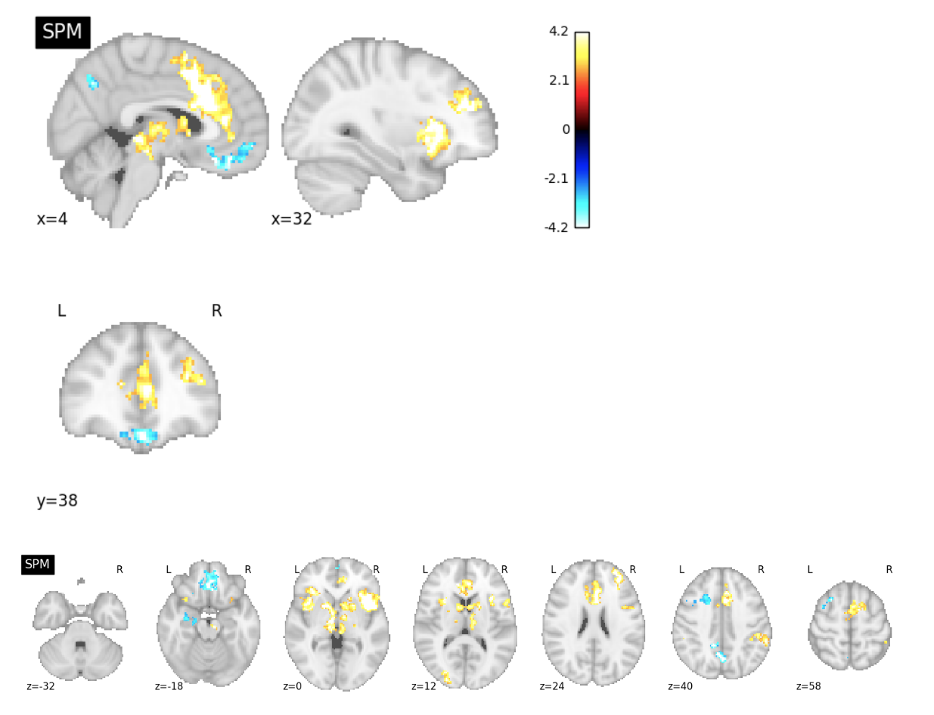
Software Comparison Figures
ds001 Reproduction Excursion Set Map Slice Comparisons

Slide 2
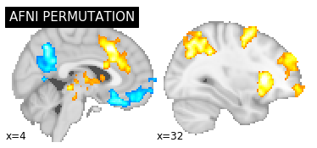
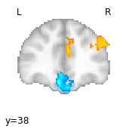
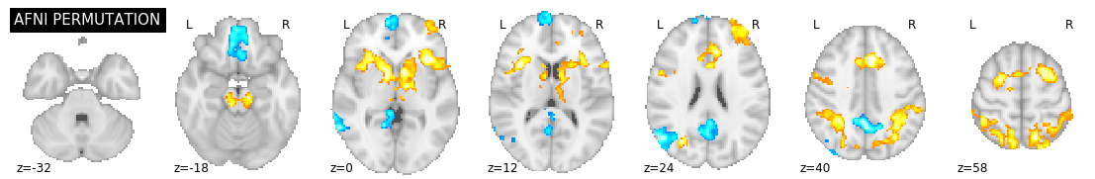
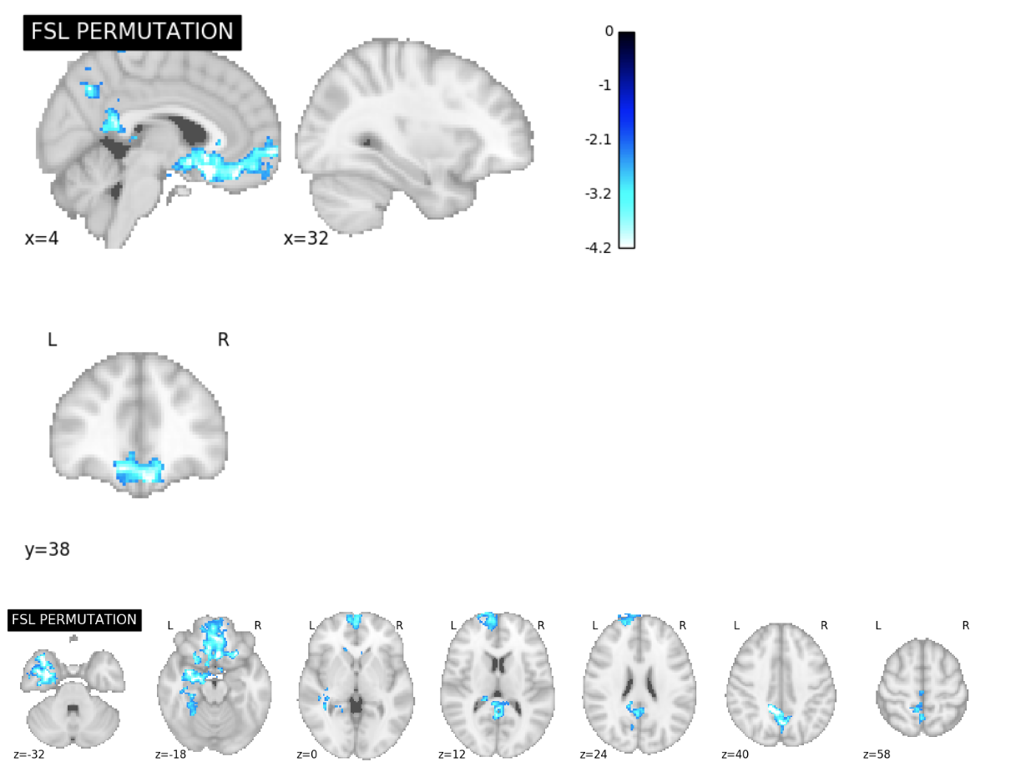
ds001 Permutation Test Excursion Set Map Slice Comparisons

Slide 3
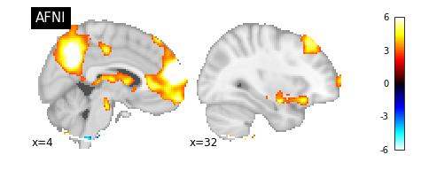
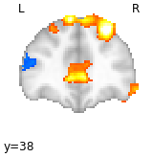
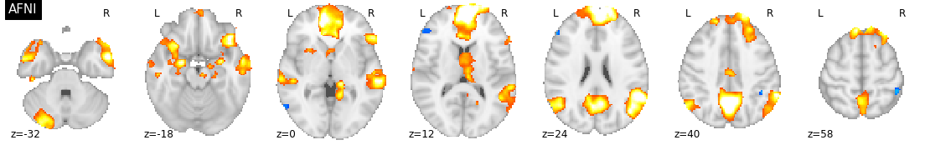
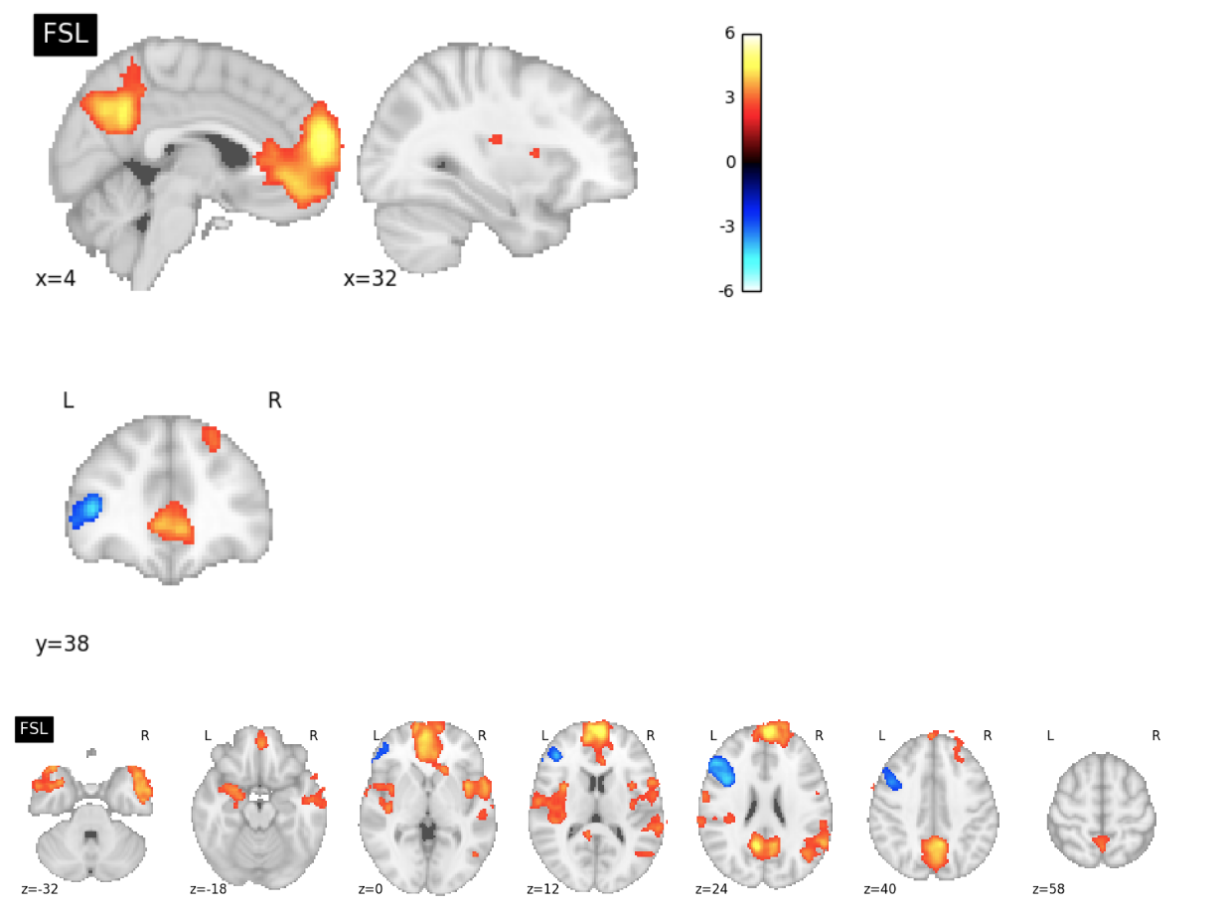
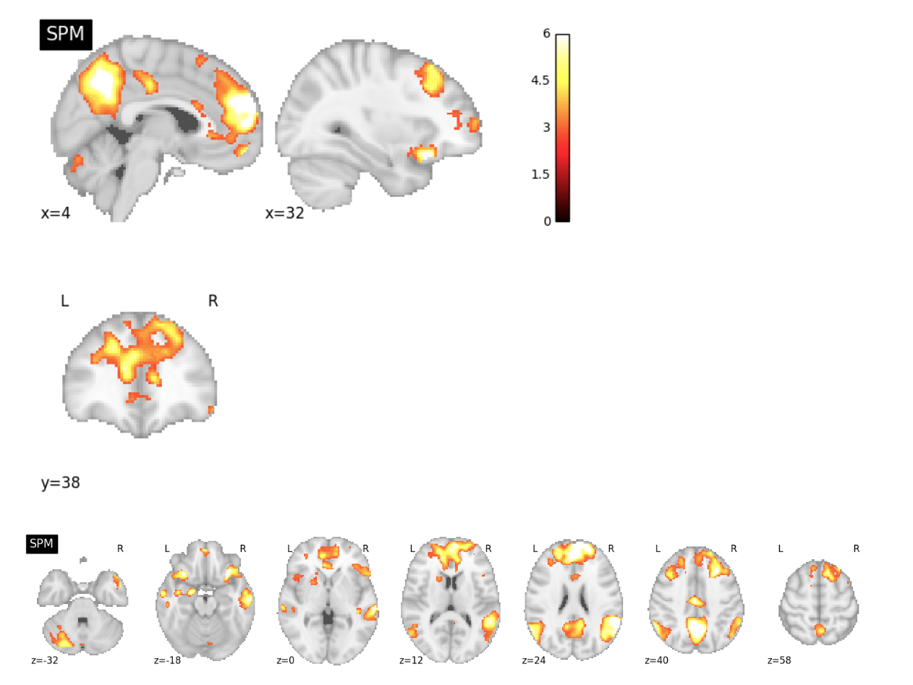
ds109 Reproduction Excursion Set Map Slice Comparisons

Slide 4
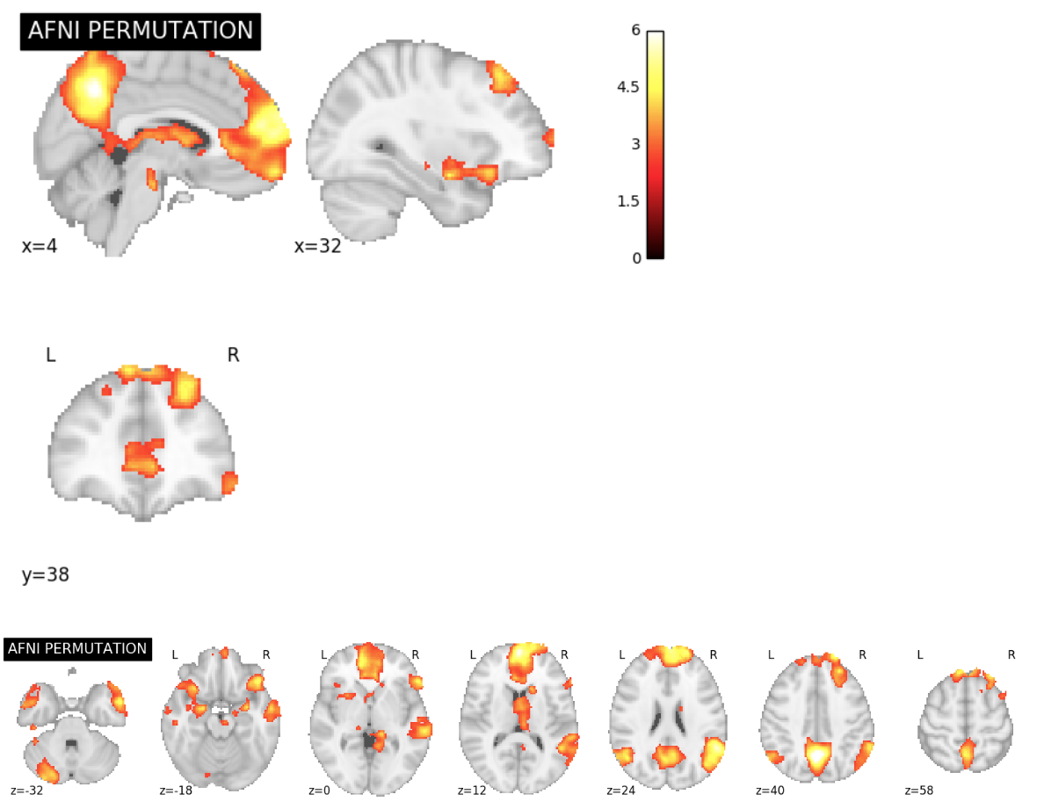
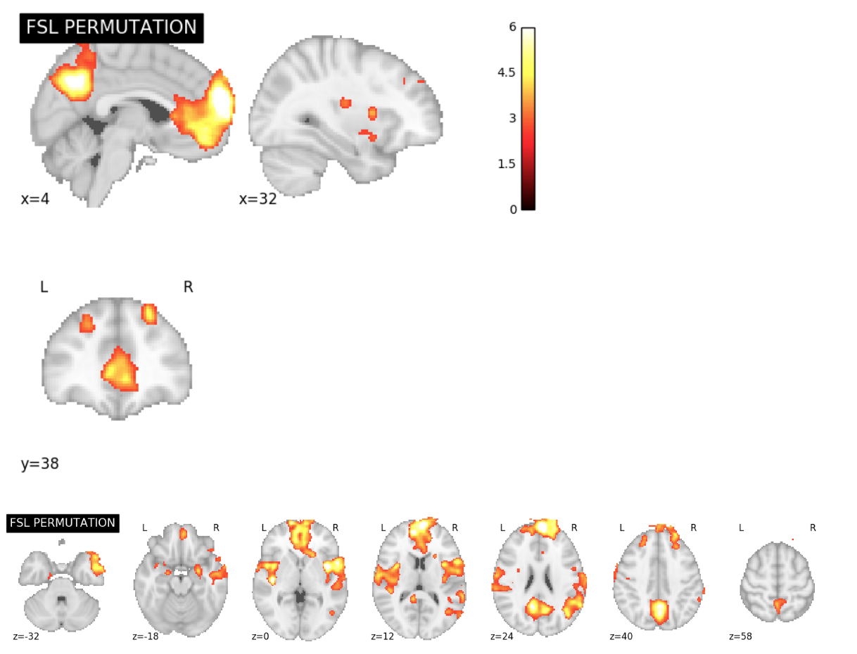
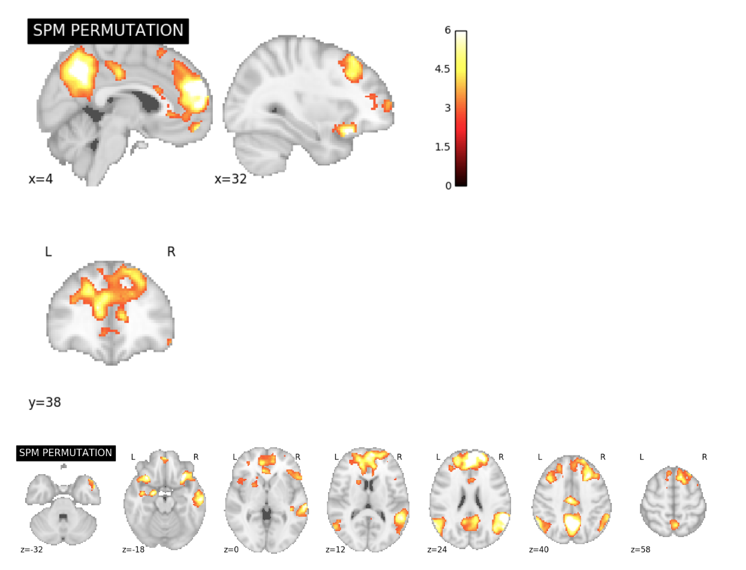
ds109 Permutation Test Excursion Set Map Slice Comparisons

Slide 5
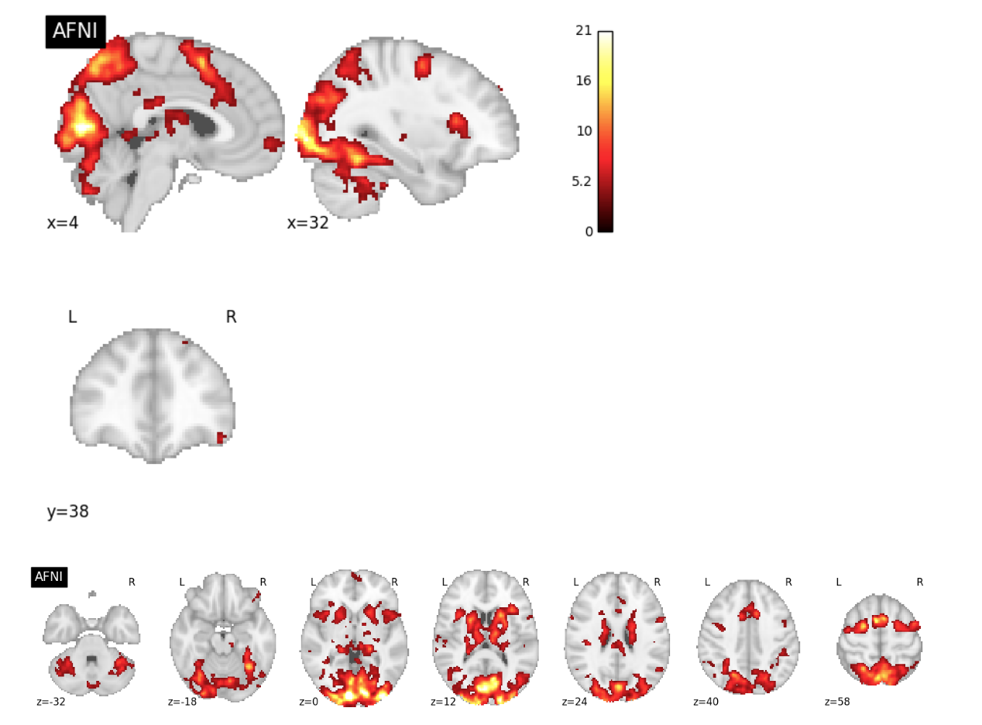
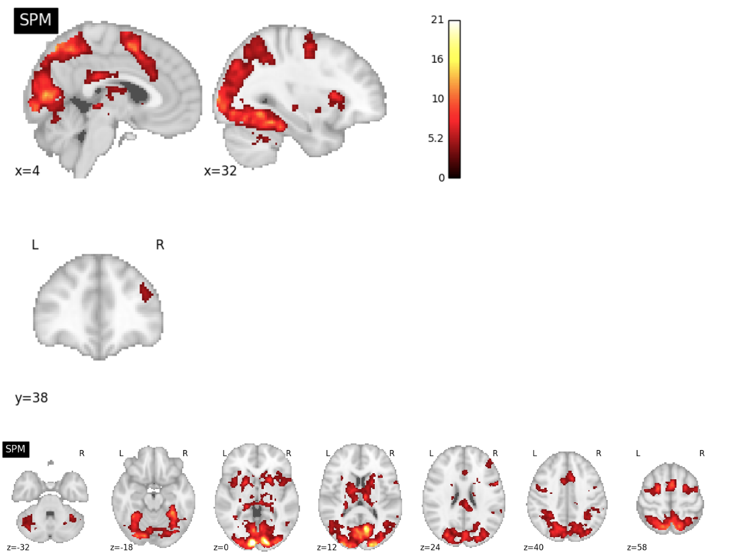
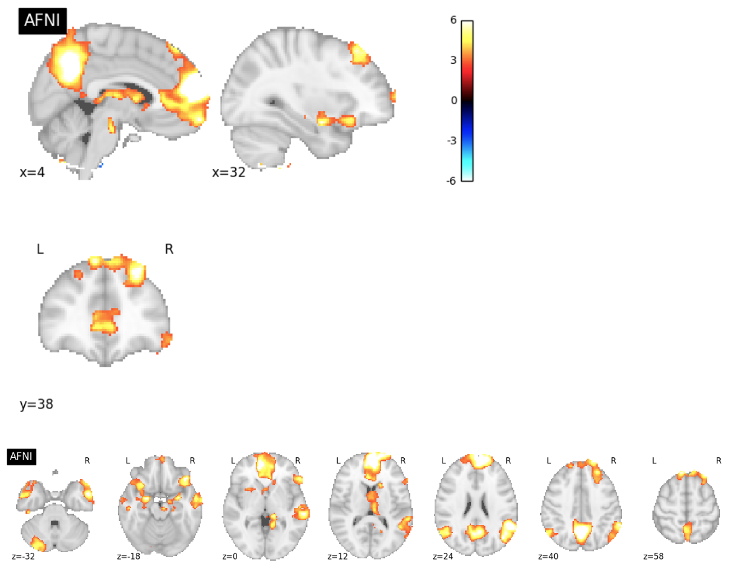
ds120 Reproduction Excursion Set Map Slice Comparisons

Slide 6
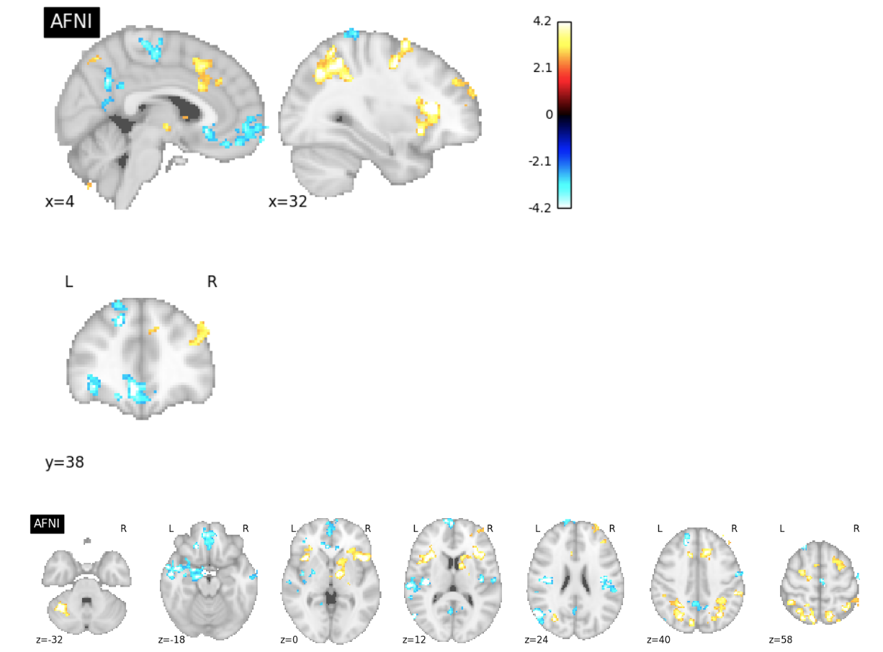
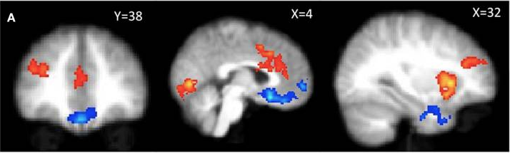
ds001 Publication Figure Reproduction
PUBLICATION
4.2
-2.3
2.3
-4.2

Slide 7
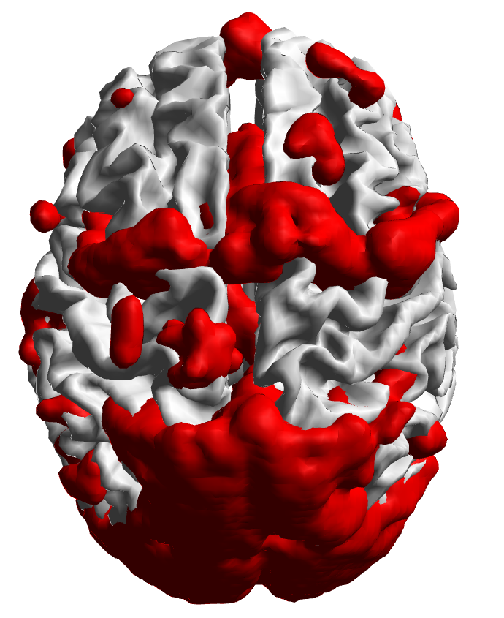
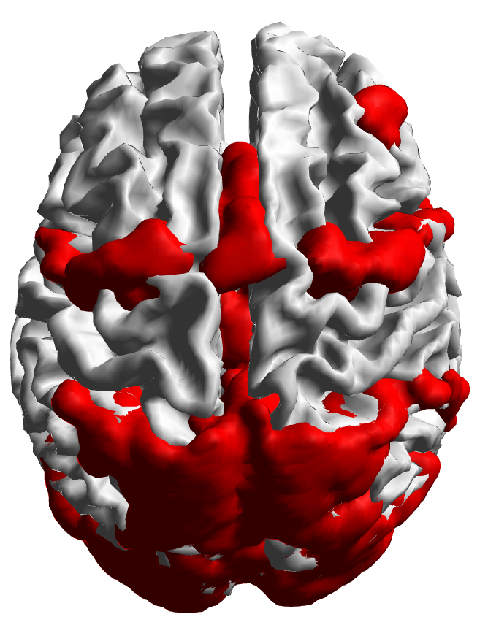
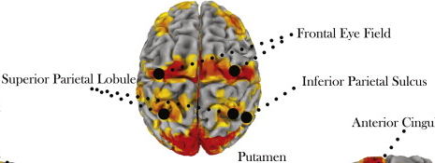
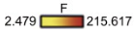
ds120 Publication Figure Reproduction
PUBLICATION

Slide 8
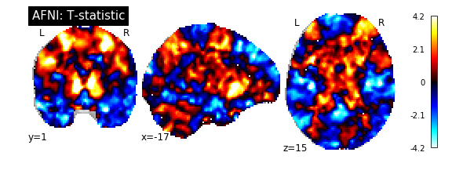
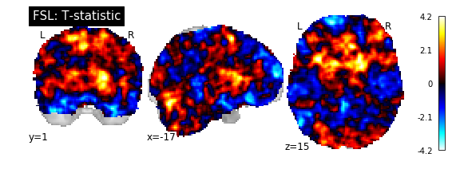
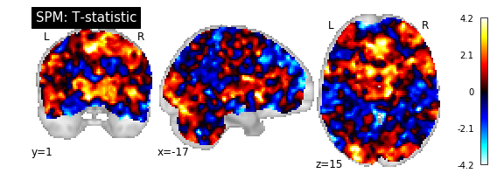
ds001 Reproduction T-Statistic Map Slice Comparisons

Slide 9
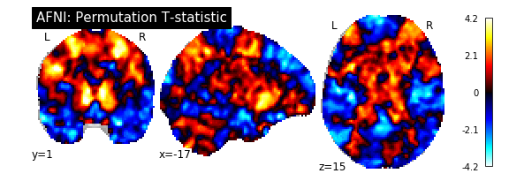
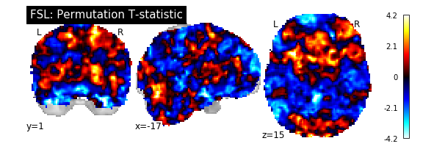
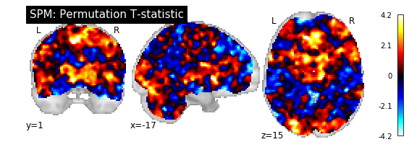
ds001 Permutation Test T-Statistic Map Slice Comparisons

Slide 10
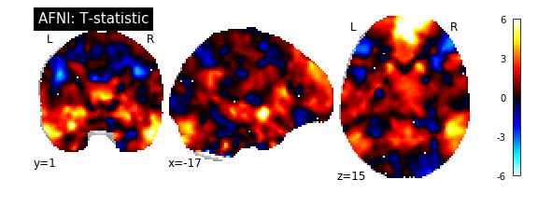
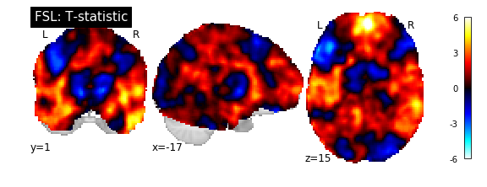
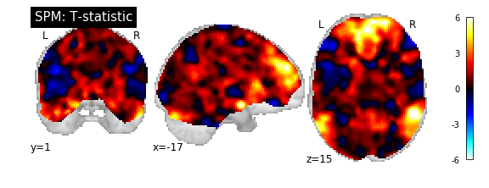
ds109 Reproduction T-Statistic Map Slice Comparisons

Slide 11
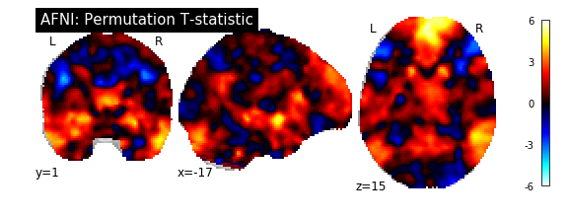
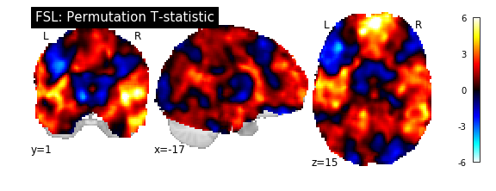
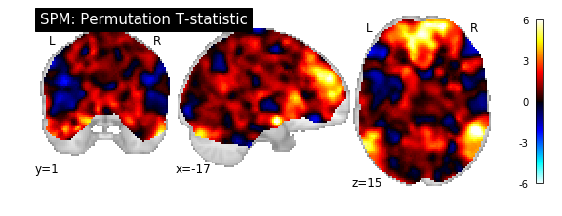
ds109 Permutation Test T-Statistic Map Slice Comparisons

Slide 12
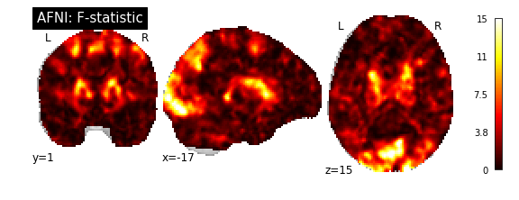
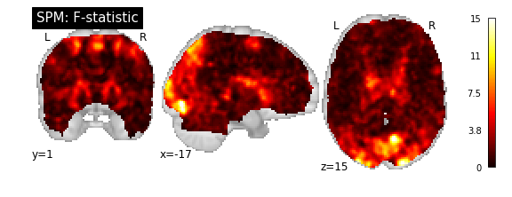
ds120 Reproduction F-Statistic Map Slice Comparisons

Slide 13
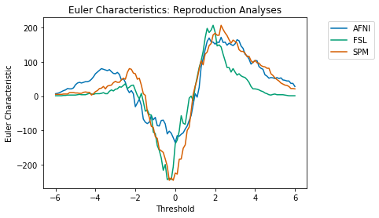
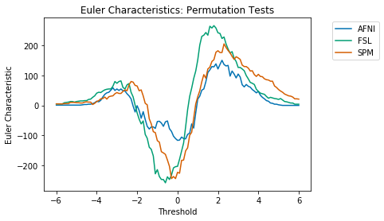
ds001 Euler Characteristics

Slide 14
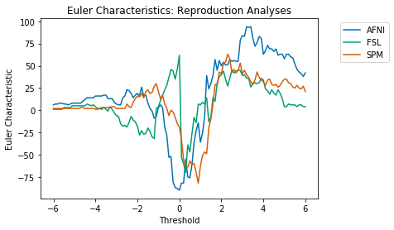
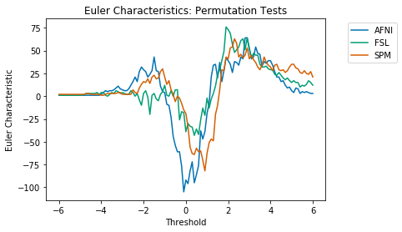
ds109 Euler Characteristics

Slide 15
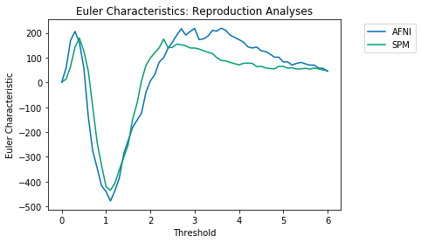
ds120 Euler Characteristics

Slide 16

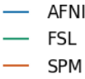
Euler Characteristics
ds001
ds109
Reproduction Analyses
Permutation Test Analyses

Slide 17
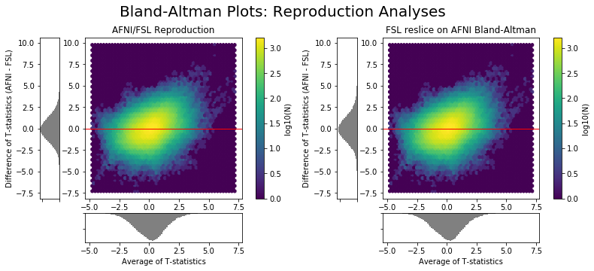
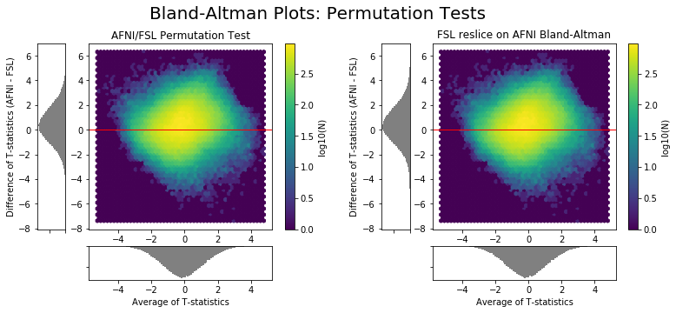
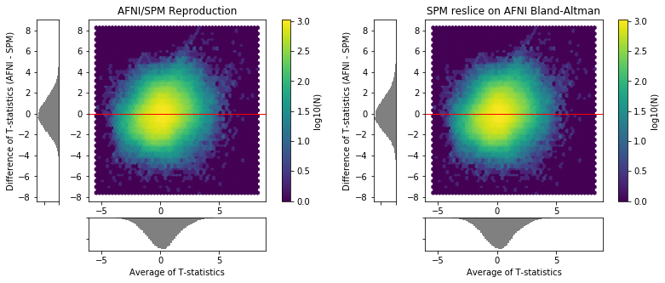



Bland-Altman Plots: ds001
Reproduction Analyses
Permutation Tests

Slide 18






Bland-Altman Plots: ds109
Reproduction Analyses
Permutation Tests

Slide 19
Bland-Altman Plots: Reproduction Analyses
ds001
ds109

Slide 20

Bland-Altman Plots: Reproduction Analyses
ds120

Slide 21
Bland-Altman Plots: Permutation Tests
ds001
ds109

Slide 22




Bland-Altman Plots: Intra-Software Comparisons
ds001
ds109

Slide 23


ds001 Dice Coefficients

Slide 24

ds109 Dice Coefficients

Slide 25

ds120 Dice Coefficients

Slide 26
Dice Coefficients
ds001
ds109
ds120
Positive Activation Dice Coefficients
Negative Activation Dice Coefficients

